Slide 1
CLASSROOM RULES
1 - Be on time
2 - Be interactive
3 - 100% or nothing
4 - Do all daily challenges

Slide 2




Review speaking
JOBS
SCHOOL
HOBBIES
FAMILY - DESCRIBE PEOPLE

Slide 3
Lesson 11:
Prepositions
Brought to you by LangGo

Slide 4
Objectives
01
02
Identify prepositions in sentences.
Understand the function and usage of some common prepositions

Slide 5

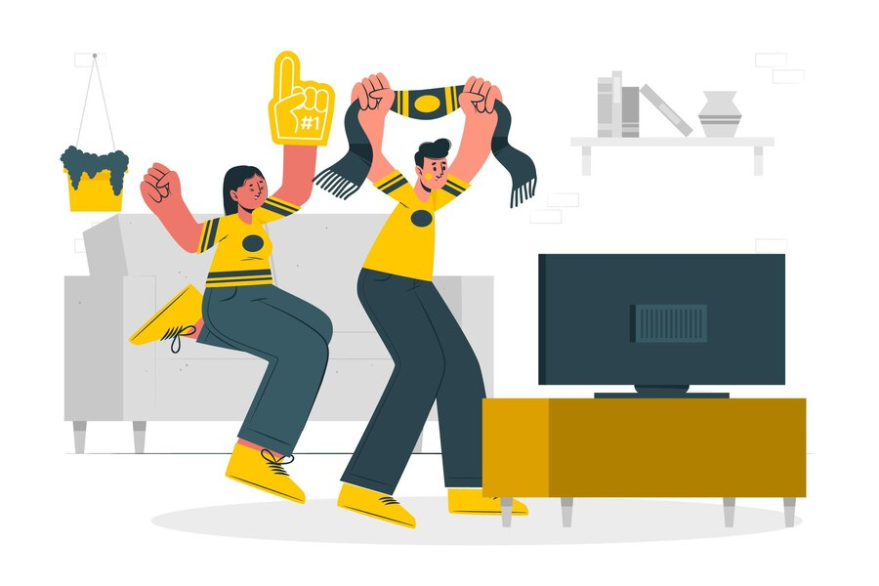
DEFINITION
There is a big balloon in the sky.
We watched that World Cup game until 2.00 AM.
A preposition is a word that connects one thing with another, showing how they are related.
Prepositions usually tell you about position, place or time.

Slide 6

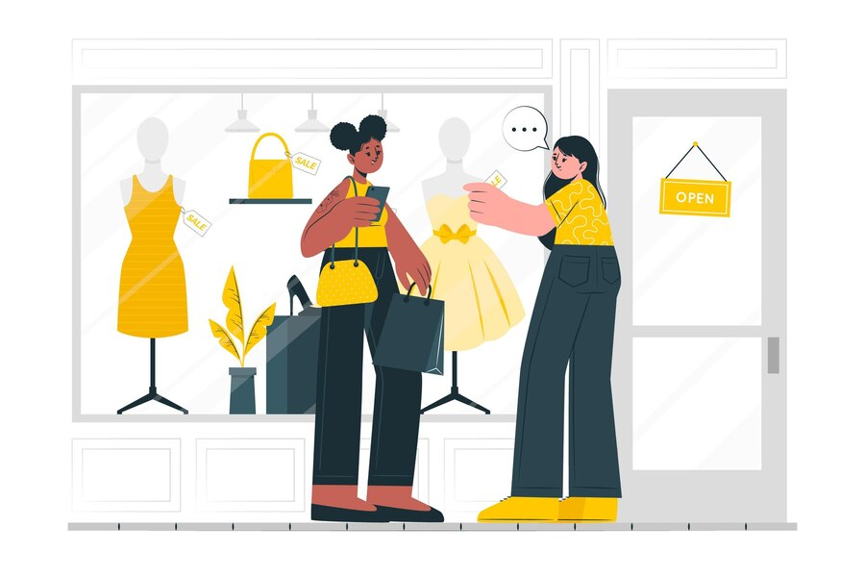
POSITION
There is a book on the table.
The dress behind me is beautiful.
A preposition is usually followed by a noun or pronoun.

Slide 7
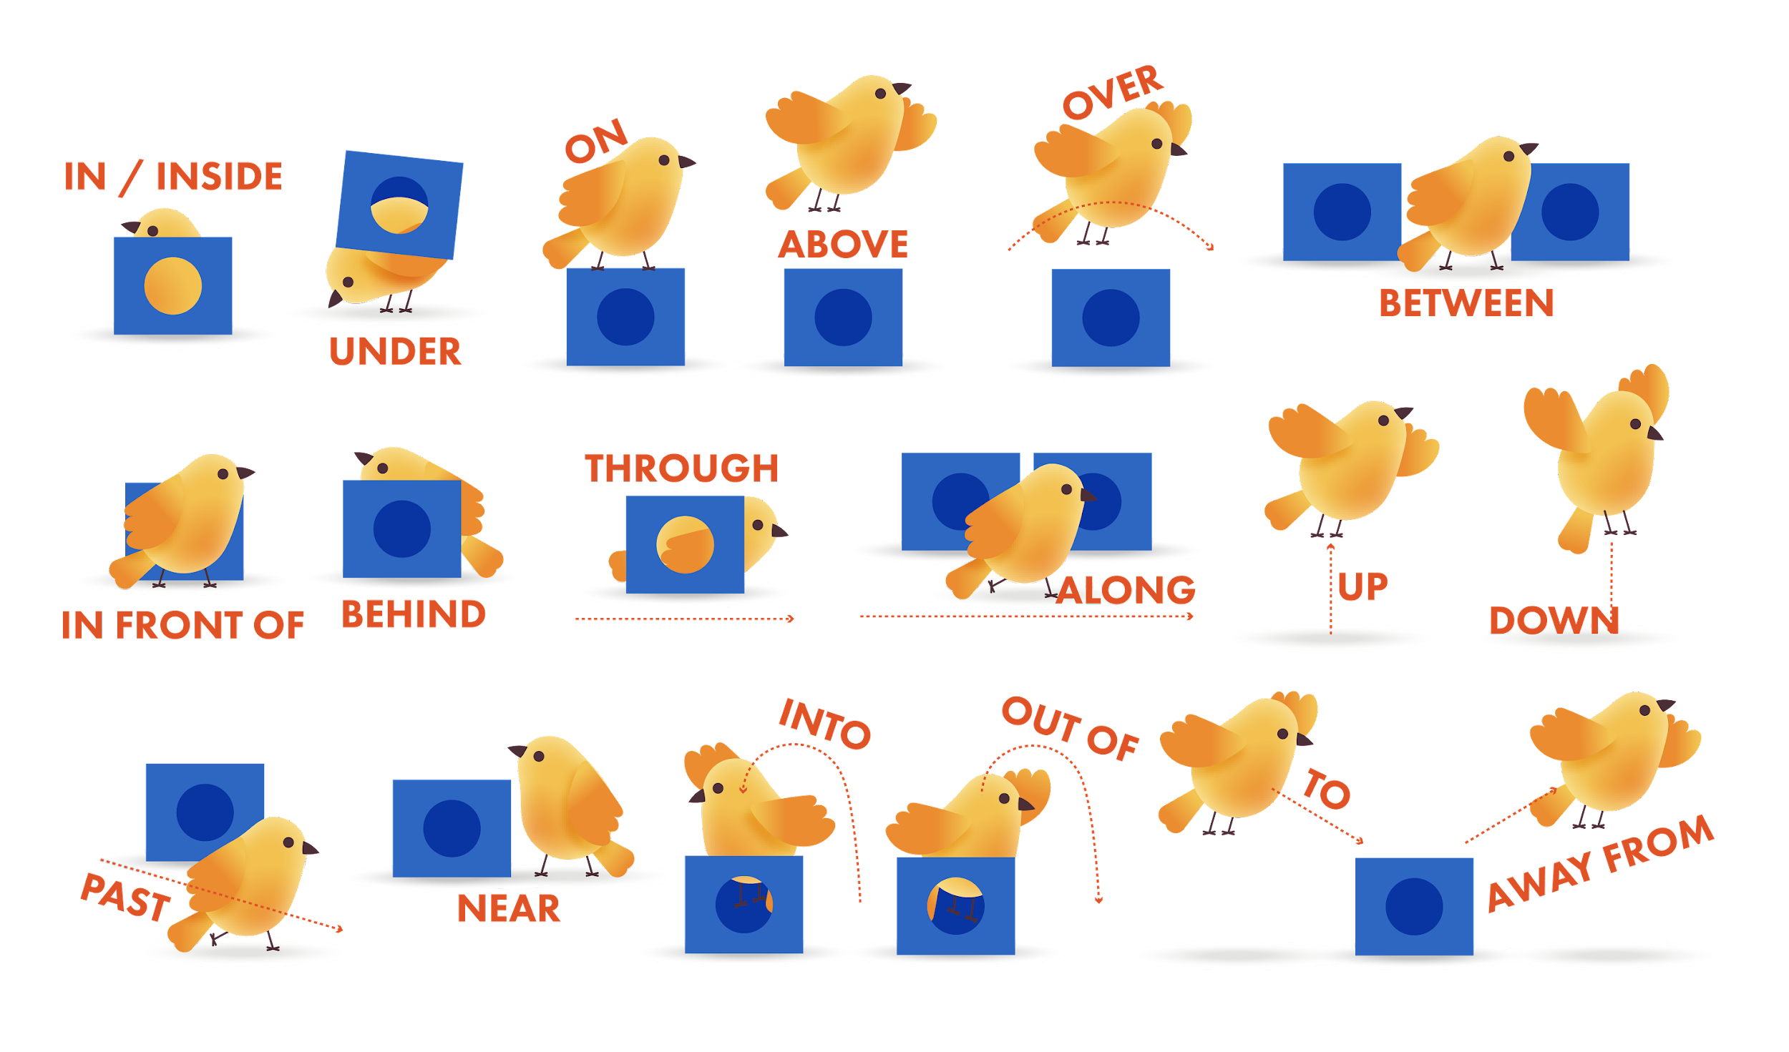
COMMON PREPOSITIONS ABOUT POSITION

Slide 8
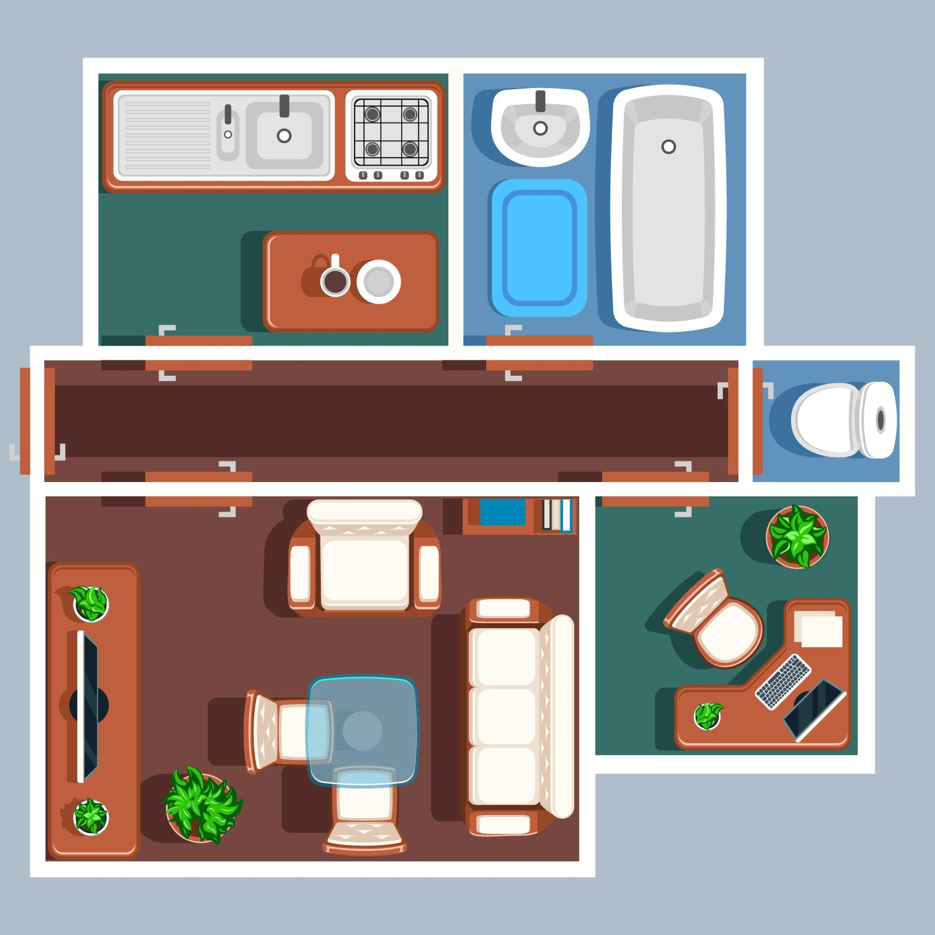
Door
Armchair
Desk
TV
Sofa
Coffee table
Wall
Plant

Slide 9

A is ...
Next to / Near…
In front of…
In the middle of…
In the corner...
On the left/right of…
To the left/ right of…
Across from/ opposite…
Against the wall

Slide 10
The door is across from/opposite the plant.
The armchair is between the desk and the door.
The TV is on the left of the room.
The desk is to the right of the sofa.
The plant is to the left of the chair.
The sofa is against the wall.
The coffee table is in the middle of the room.

Slide 11
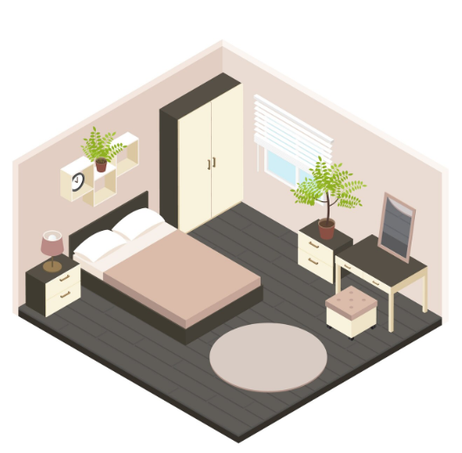
Look at the picture. Choose the correct answer
The wardrobe is______ the window.
next to
behind
in front of
2. The bed is_____ the room.
to the left
on the left
in the right
3. The mat is____ the floor.
above
under
on
4. The lamp is_____ of the bed.
to the left
on the right
in the right

Slide 12
IN/AT/ON

Slide 13
IN
Time | Example | Place | Example
Months | Paris is wonderful in April. | Towns/cities | I live in Ha Noi.
Years | I first went to Russia in 2005. | Countries | My brother is in Mexico.
Seasons | We often go skiing in winter. | Areas/regions | What’s life like in the desert?
Parts of the day | My train leaves in the morning. | Inside an object | Your passport is in the drawer.
 |  | Inside a room | We have dinner in the kitchen.
 |  | Inside a building | He stayed in the hospital.

Slide 14
AT
Time | Example | Place | Example
Clock times | There’s a bus at ten past three. | Specific places | What’s it like at North Pole? I think John is at the cinema, watching the movie “Titanic”.
Holiday periods | What are you doing at Christmas? | Addresses | My cousin lives at 132 London Road.
 |  | Events/Activities | Raina isn’t here. She’s at a party.
IN: dùng cho địa điểm lớn
AT: dùng cho địa điểm nhỏ hơn, cụ thể hơn
We’re spending our next holiday in the countryside.
Let’s meet at the train station.

Slide 15
ON
Time | Example | Place | Example
Days | I got a new car on Saturday. | Islands | Last year, we stayed on Long Beach island.
Dates | My birthday is on 19th March. | Pages | The important information is on page 23 of the report.
 |  | On top of an object | Did you put your car keys on the kitchen table?
 |  | On a surface | The timetable is on the wall.
We say in the morning/afternoon/evening, but on Monday morning/Wednesday evening/...
Eg:We’re flying to Washington in the morning / on Tuesday evening.
Không dùng giới từ với: tomorrow, yesterday, tomorrow morning, yesterday evening.
Eg: We’re flying to Washington tomorrow afternoon.

Slide 16
IN năm IN tháng IN mùa
In sáng chiều tối, ngày đưa ON vào
Đêm trưa giờ phút tính sao
Thêm AT đằng trước thế nào cũng xong

Slide 17
LET’S PRACTICE

Slide 18
Fill in the blanks with the correct in/on/at or ∅ if there is no preposition.
We are going ____ a holiday ____ the 31st January.
I am going to the hospital ____ tomorrow.
They met David ____ Monday evening.
She is staying home ____ August because she is ____ holiday.
He will call you back ____ tomorrow evening.
When will you come? ____ New Year’s Eve.
____ the morning, there are a lot of birds here.
You are leaving ____ 7 o’clock, right?
When is New Year? ____ Sunday!
When was the last time you saw him? I saw him ____ 10 am yesterday.

Slide 19
Fill in the blanks with the correct in/on/at or ∅ if there is no preposition.
We are going on a holiday on the 31st January.
I am going to the hospital ∅ tomorrow.
They met David on Monday evening.
She is staying home in August because she is on holiday.
He will call you back ∅ tomorrow evening.
When will you come? on New Year’s Eve.
In the morning, there are a lot of birds here.
You are leaving at 7 o’clock, right?
When is New Year? On Sunday!
When was the last time you saw him? I saw him at 10am yesterday.

Slide 20

GOODBYE!

